Slide 1





VDOE Updates
Dr. Joan Johnson, Assistant Superintendent, Teacher Education and Licensure
Ms. Johnelle M. Torbert, Director, Teacher Education
VACTE March 2, 2023

Slide 2
Overview
Introduction of the Team / Department Updates
Teacher Education Deadlines and Reminders
Legislative Updates
Apprenticeship Program Background
VDOE Teacher Apprenticeship Model
Q & A

Slide 3
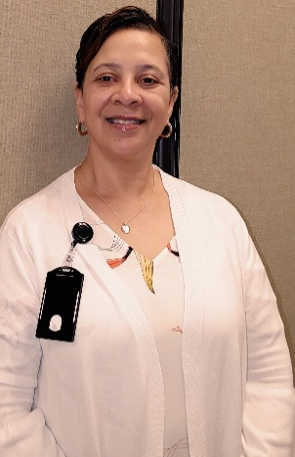
Department of Teacher Education and Licensure
Director Teacher Education
EPP Program Approval and Accountability
EPP CAEP Accreditation Liaison
Grant Incentive Teacher Preparation
Workforce Data Critical Shortages
Engagement Specialist
Advisory Recruitment & Retention
Strategic Plan for Recruitment and Retention
Educator Recognition
Educator Pipeline Expansion
Director Professional Practice
Licensure Misconduct/Revocation
Superintendent Investigative Panel Hearings
Director Licensure & School Leadership
K-12 Licensure, Renewal
Alternative Program Approval
Grants K-12 Incentive
K-12 Data Instructional Personnel
National Board Certified Teachers
Assistant Superintendent
Strategic Planning Licensure and Teacher Education, Liaison Region I Supt.
Performance Evaluation
Advisory Board Teacher Education & Licensure Staff Liaison
Governor’s Executive Directive ED3
Teacher Apprenticeships
Sonya Broady, Executive Adm. Assistant
Notes:
Intro of our team and those that will be presenting with me today.. Johnelle Torbert, and Sonya

Slide 4
VDOE Communication and Engagement
Website
Licensure & Teacher Education Updates (Chief Licensure Officers/Dean/Directors)
ABTEL
BOE *

Slide 5



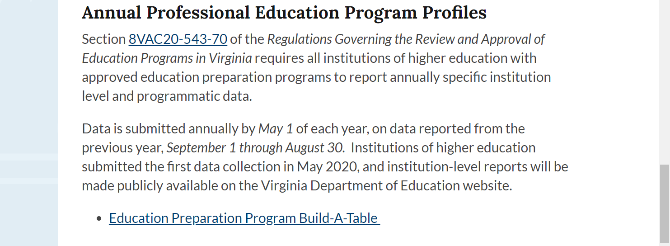

New Web Page Branding & Logo
https://www.doe.virginia.gov/

Slide 6
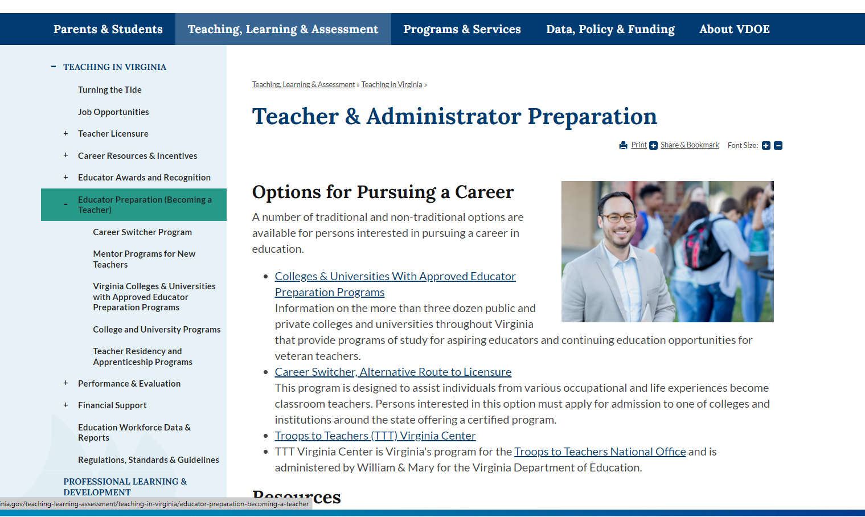

Slide 7
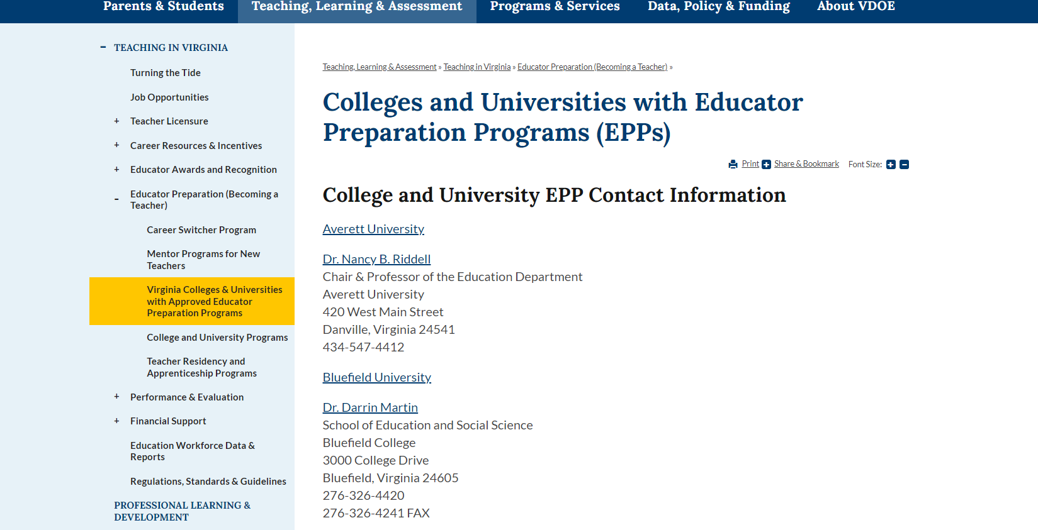

Slide 8
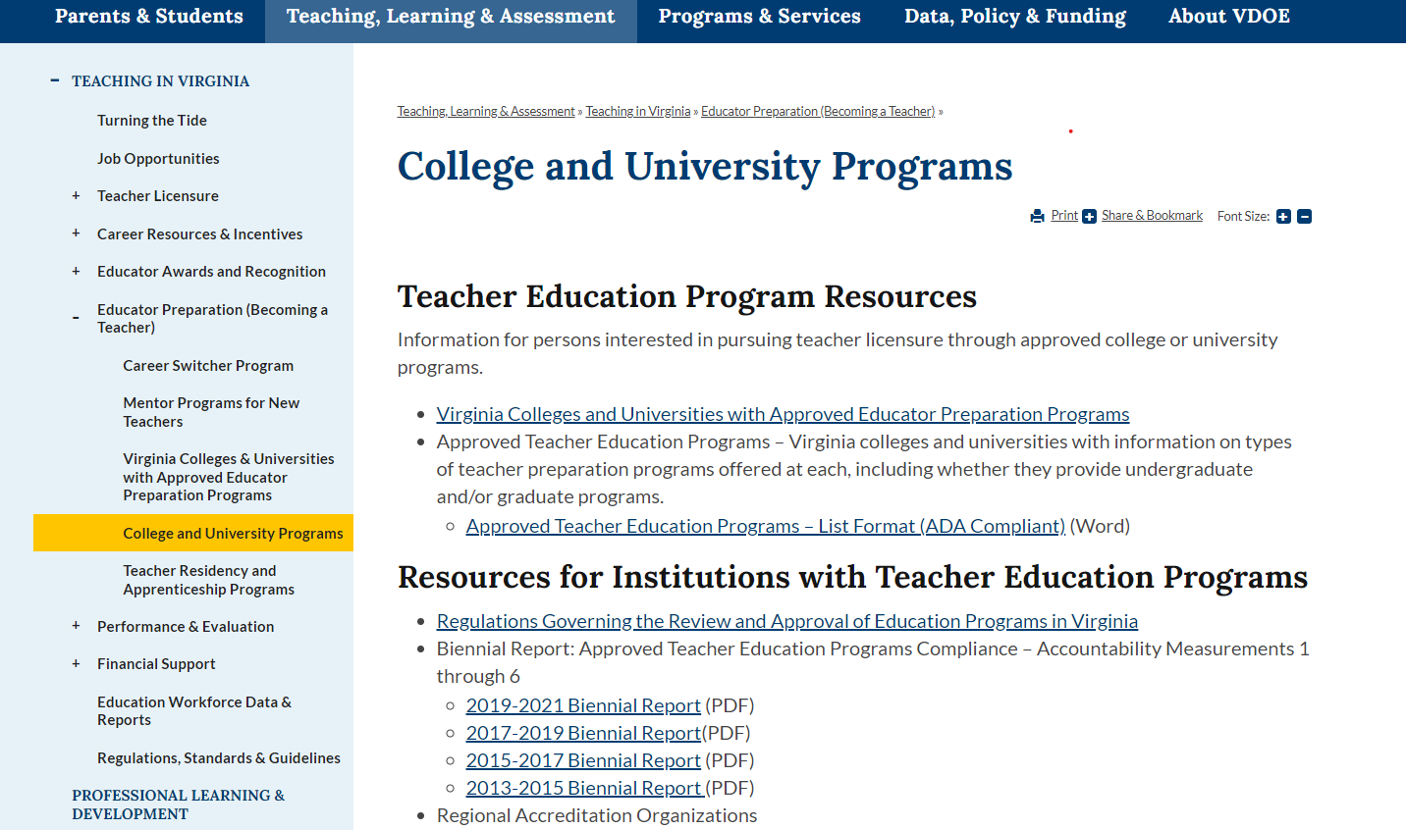

Slide 9


Slide 10
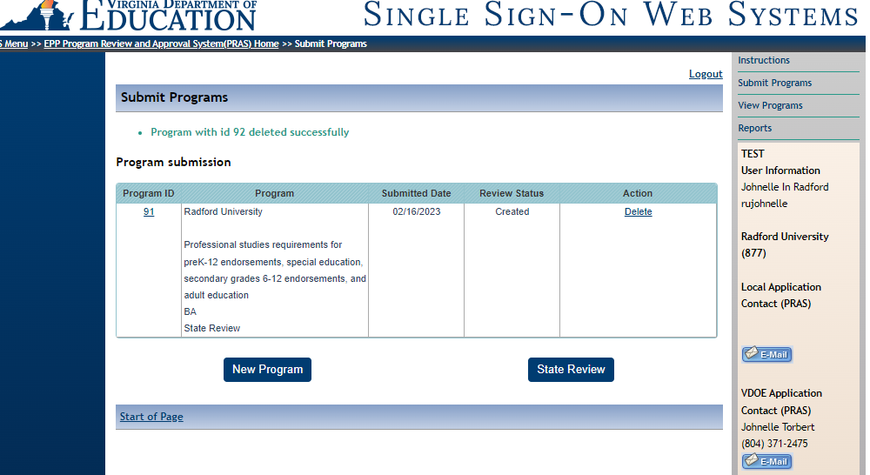
Program Review and Approval System (PRAS)-New Feature

Slide 11



becomeateacher.virginia.gov
Notes:
Johnelle
In addition to the new VDOE website, our department's BecomeATeacher microsite continues to see great success, with an average of 350-400 users per day with a record 700 users at the end of January!
Performance data tells us that most visits are coming from our social media ads like you see here and from google paid searches.
Of note, is that visitors appear to be primarily interested in EPP and Career Switcher resources
Electronic materials are available for division and EPP- create posters or for webpages etc..

Slide 12



VDOE Communication
New TEAL Social Media Accounts!
  Important Updates from the VDOE
  "Educator Spotlight" stories from the field
Follow us!
  Facebook: Department of Education_TEAL
  Twitter: @VDOE_TEAL
  Instagram: VDOE.TEAL

Slide 13
Council for Accreditation of Educator Preparation (CAEP) Agreement
Current agreement is for the five-year period beginning August 1, 2022, and ending on July 31, 2027
A Change to Agreement:
Joint Review Team
4.4.1.2. For a Review involving both levels of accreditation, initial- and advanced-level, the Evaluation Team will include five CAEP-appointed reviewers and one state-appointed reviewer. Contingent upon availability, two reviewers may be appointed by the state to serve on a team; however, it is not required.
Notes:
Johnelle

Slide 14
Important Dates to Remember
Annual Education Preparation Program Profile Info Session:
  Wednesday, March 29, 2023
Annual Education Preparation Program Profile:
  Submission Deadline: May 1, 2023
Title II Report- Institution and Program Report Card (IPRC)-
  Deadline: April 30, 2023
  (The Institution and Program Report Card (IPRC) data collection (February through April) )
Notes:
Johnelle

Slide 15

Wednesday,
March 29, 2023
ANNUAL EDUCATION PROFILE
INFO SESSION
Notes:
Johnelle

Slide 16

Paid Internship Scholarship: Cycle IV
Paid Internship Scholarship for Aspiring Virginia Educators
  Cycle IV to be announced in March
    Nominate (2) students for Fall 2023 funding
  Materials will be sent to Deans/Directors this month
    EPP Program will identify candidates to nominate
    EPP Program will alert their nominees
    Nominees will attend an info session by the VDOE
    Nominees will complete the application and return to the designated EPP rep
    EPP rep will submit complete application by deadline
  Applications due to VDOE in April (SSWS)
  Fall 2023, Spring 2024, and Fall 2024
Complete information available in email from Dr. Meg Homer

Slide 17
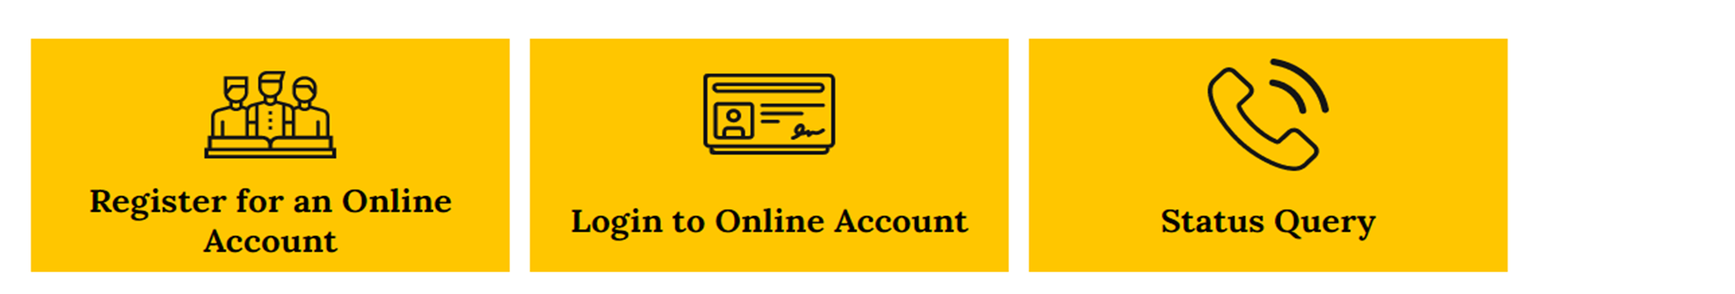

EGov- Pilot Procedures (Register & $ sp 2022)
Notes:
Joan
Licensure Software: online licensure application and request portal launched in the spring 2022, now capacity for initial , renewal and few other services. More to come...customizable dashboard for staff end users and licensed users to keep communications in one place and trackable.
Given diversity of methods EPPS are submitting or supporting candidates in licensure application process... as we pilot this new system.. Director suggest EPPS consider.. Having individuals create/Register and pay online.. Then EPP administrator can upload components and submit CVF using, SSWS—Licensure document Need PKID# to submit documents using SSWS, if done by separate folks. Reduce the delay and mailing with individual

Slide 18
Positions and Exits Collection (PEC)
Code of Virginia § 22.1-79 and 22.1-290.2
Requirements of the Code of Virginia and ESEA TITLE II
Local school boards were required to report the number and type of teacher, other instructional personnel, and support staff vacancies as well as bus drivers (Oct 2021).
Identify critical shortages by geographic area, school division, and subject matter, measure growth and decline of required staffing levels, and evaluate the reasons licensed personnel leave the field (exit) (June 30, 2022).
Replaces the Supply and Demand Survey and the IPAL Survey Data collection beginning with the 2021-2022 school year.

Slide 19
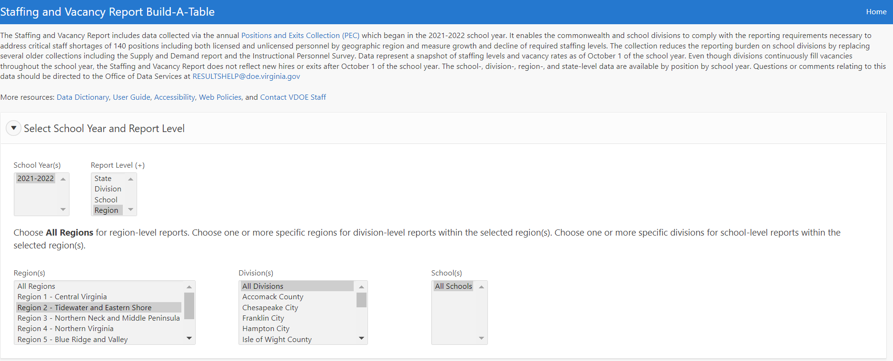
Build-A-Table Sample
https://www.doe.virginia.gov/teaching/workforce_data/index.shtml

Slide 20
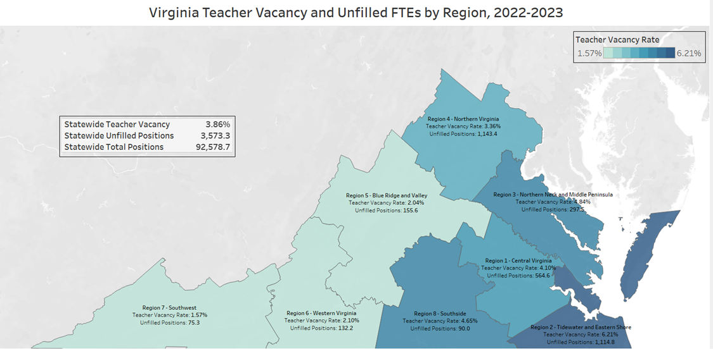

Slide 21
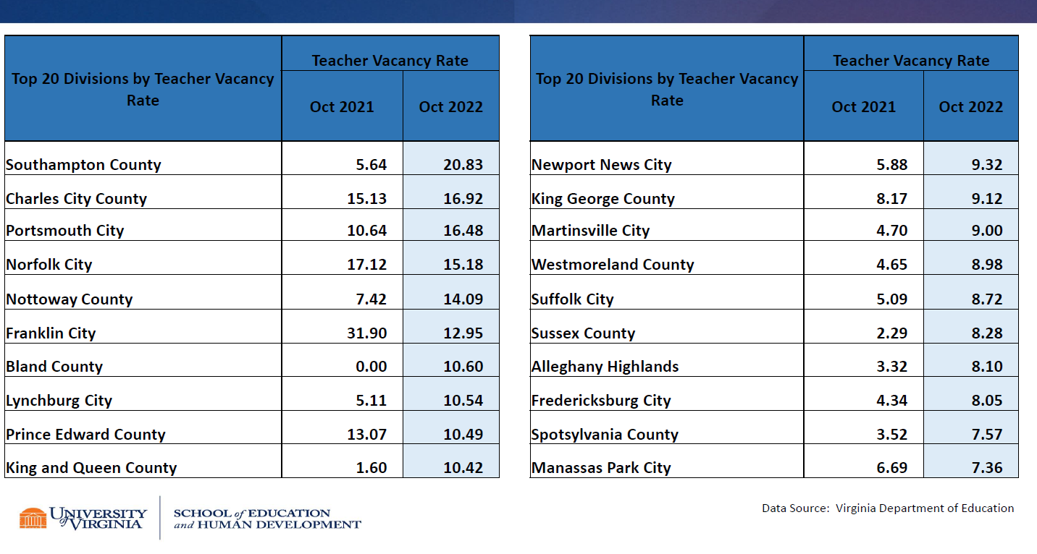

Slide 22
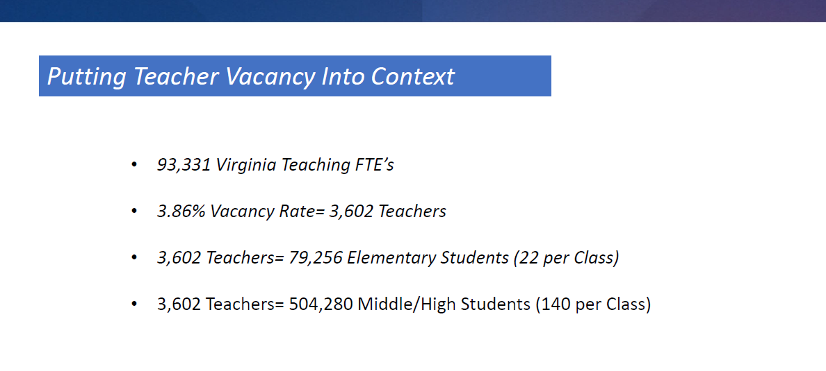

Slide 23
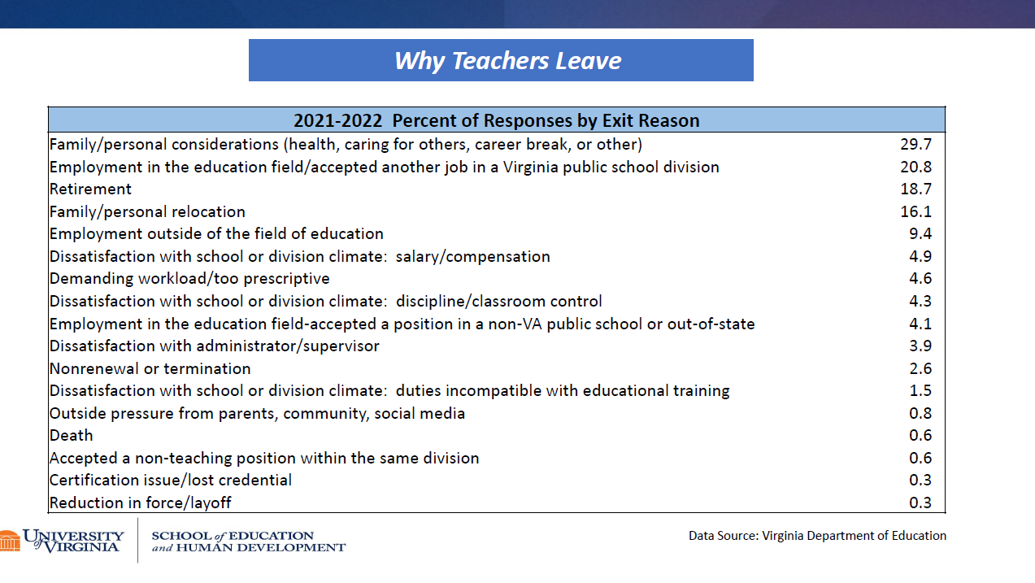

Slide 24
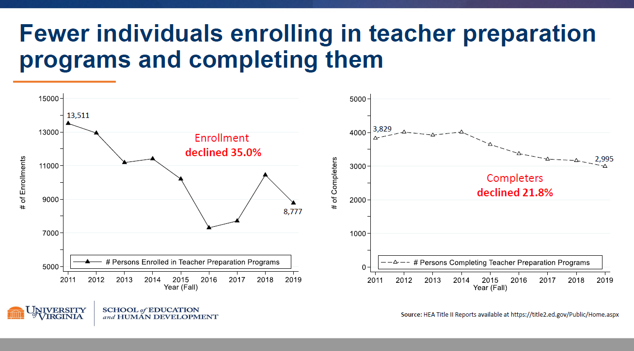
Center on Education Policy and Workforce Competitiveness
Notes:
Dr.Luke Miller

Slide 25
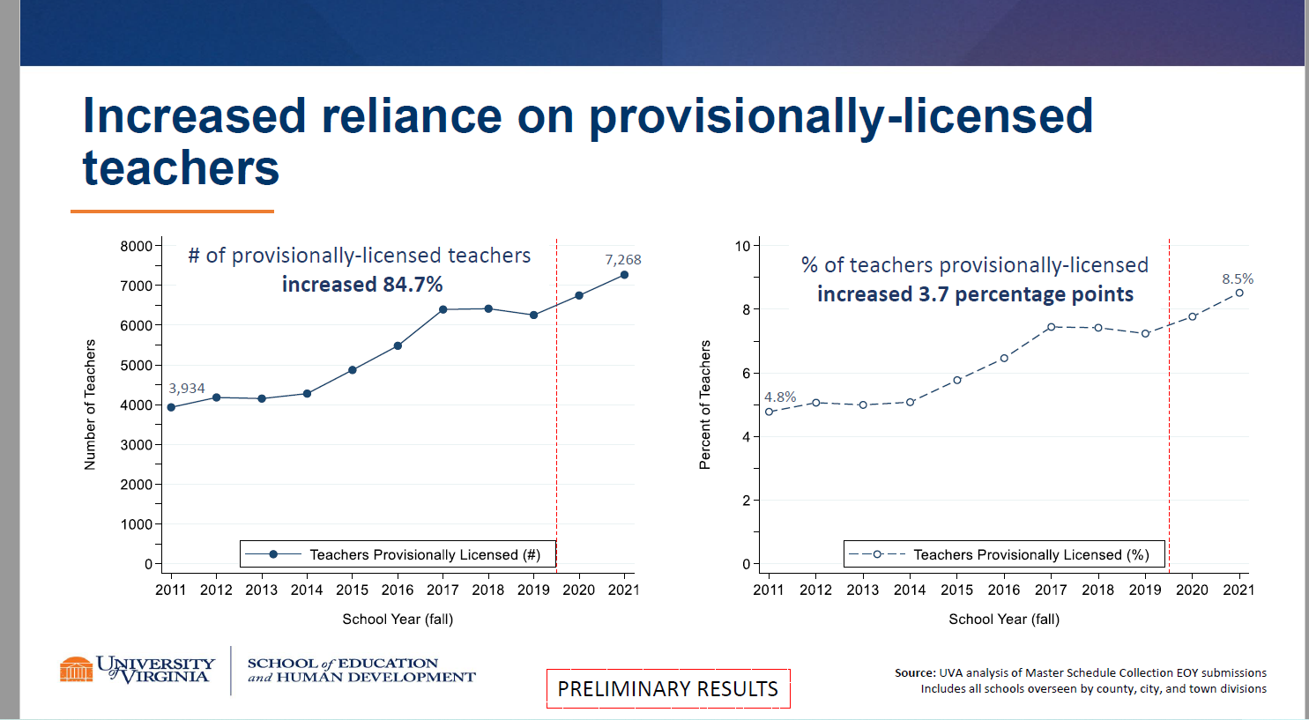

Slide 26
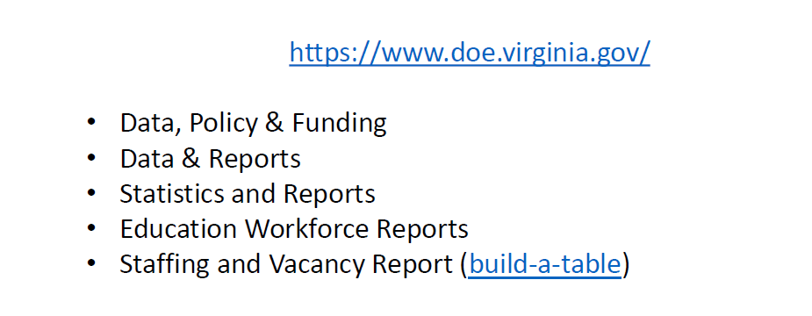
Detail Teacher Vacancy Data
https://www.doe.virginia.gov/teaching-learning-assessment/teaching-inhttps://www.doe.virginia.gov/teaching-learning-assessment/teaching-in-virginia/education-workforce-data-reports-virginia/education-workforce-data-reports
https://www.doe.virginia.gov/teaching-learning-assessment/teaching-in-virginia/education-workforce-data-reports
Notes:
https://www.doe.virginia.gov/teaching-learning-assessment/teaching-in-virginia/education-workforce-data-reports

Slide 27
Strategies for Change and Impact:
Cross Agency Collaboration
Department of Labor and Industry's Registered Apprenticeship

Slide 28
In Virginia, the United States Department of Labor and Industry (DOLI)….
(DOLI) maintains approximately 15,000 apprentices serving in the private and public sectors, and in the military settings.
One of DOLI’s missions is to improve opportunities for business and employees in the commonwealth and to contribute to economic development and quality of life for all Virginians.
School divisions and youth have benefited from the existing Virginia Youth Registered Apprenticeship (YRA) program for many years.
Commission Governance Structure
2021 K-12 Teaching "Apprenticeable"
Notes:
In November 2021, the US Department of Labor, Office of Apprenticeship approved K-12 teaching as an “apprenticeable” occupation. As a result, programs that train and provide workforce development opportunities for K-12 teachers are now eligible to apply and become “registered apprenticeship” programs.
Va teach for tomorrow

Slide 29
Department of Labor Regulations
According to Chapter 6, Title 40.1 Code of Virginia Section 4. Apprenticeship Agreements - Governing Documents
  Outlines what it takes to be a Program Sponsor of Registered Apprenticeship
Minimum of approximately one-year (2,000 On Job Training (OJT) hours per year)
Recommended 144 hours of Related Technical Instruction (RTI) per year of the program
Must be a starting wage and a wage upon completion with one wage increase as skills are gained

Slide 30

Registration: Sponsor and Apprentice
VDOE with Register with VDOLI – RA
Local divisions will sign an Employer Agreement with Sponsor(VDOE)
Local divisions will identify teacher apprentice candidates and coordinate with VDOE for formal apprentice registration
Supervisor of Apprenticeship – VDOE staff member will work with local division and new apprentices to help coordinate registration and technical support in relation to the program
Virginia Department of Education
Sponsor
Public Schools
Employer Partner
Mae C. Jemison, Science
Apprentice
James Baldwin, English
Apprentice
County Schools
Employer Partner
Virginia Dept. of Labor and Industry, Division of Registered Apprenticeship
State Apprenticeship Agency
City Public Schools
Employer Partner
Dorothy Vaughan, Math
Apprentice
William E. B. Du Bois, History
Apprentice
VDOE Teacher Registered Apprenticeship Program – Sample Flow Chart

Slide 31
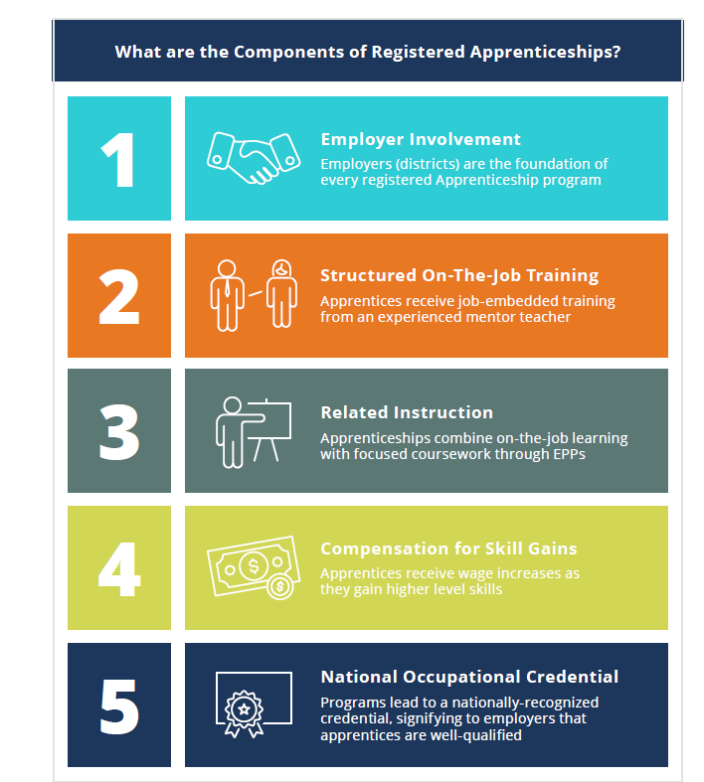

Slide 32
What are the Characteristics of the VA Apprenticeship?
Teacher
Program Types: Baccalaureate, Post-Baccalaureate Masters, Post Masters - all EPP Based Program (Degree)
EPP Partnership
Format: Residency or Traditional EPP (Culminating Clinicals)
Expert school-based mentor teachers

Slide 33
Virginia’s Programmatic Design
•Target Population: Paraprofessionals & EPP Candidates (70 or more existing credits)
•Academic Structure: Attend school in the evening/weekends (state/federal scholarships) with focused coursework and content leading to degree & licensure requirements
2-year program
clinical practice co-teaching or serving as an instructional aide alongside an expert mentor teacher (consider licensure requirements 10 weeks interns/direct teaching area of endorsement)
•Employment: Paid (progressive wage scale) to work in the school system as an instructional aide; studies under a mentor/master teacher for two years ( non-teacher of record) Apprentice Employment Commitment to Division (2 years).
•Mentor Incentive- Innovation Structure 2 yrs.*
Relevant coursework that is tightly integrated with clinical practice (DOLI Hours Required) leading to VDOE licensure

Slide 34
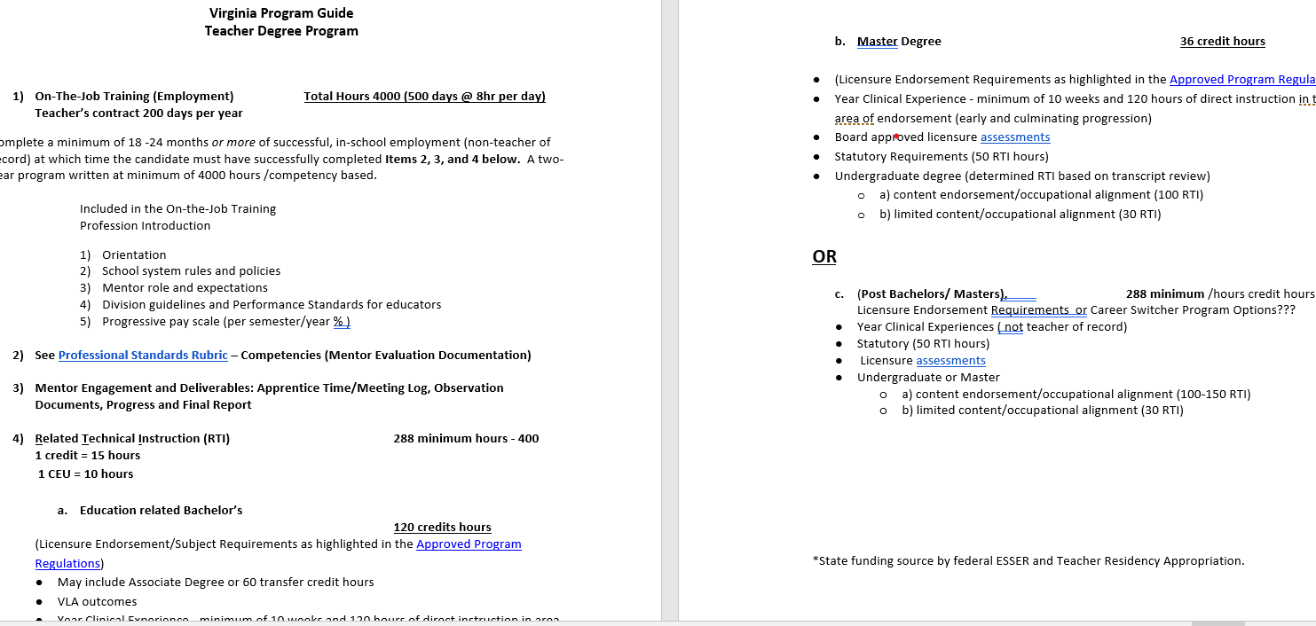


Work Process

Slide 35
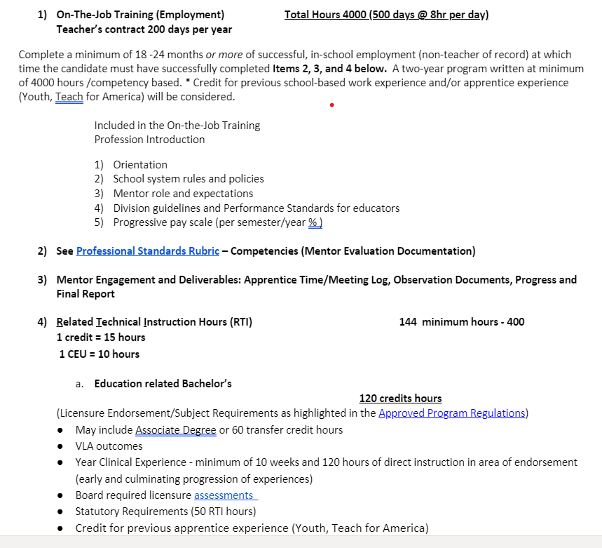
Minimum 1 year OJT
Notes:
Credit may be given for related work or school up to, but not including, the final year of the term of apprenticeship.

Slide 36
State Licensing Agency
Developed the State Apprenticeship Program
  Minimum Qualifications
  Wage Scale Minimum
  Work Processes
  Curriculum competency components linked with licensure Regulations
Program Sponsor
  Responsible for facilitating/coordination and administration of the program
  Is responsible for the training and completion of each apprentice
  Evaluations of the system, the mentor, and the apprentice
  Communicate Workforce and Federal Resources
Records keeping
  Tracking of application process, all apprentice progress, on the job, classroom, wage increases, disciplinary, etc.
  Subject to US DOL Reviews

Slide 37
Employer/Division/ Profession
Provide the on-the-job training
  Employ the Apprentice - provide on-the-job training
  Pay the apprentice wages
  Provide the apprentice's mentor
Input of what curriculum is needed
  For licensing/certification and general knowledge to be a well-rounded apprentice
  Ensure employment alignment with endorsement in final 10 weeks.
Provide evaluations and feedback on the apprentice, the program, curriculum, future contract etc.
Opportunities for mentor leadership and licensure designations

Slide 38
Educator Preparation (RTI)
EPPs can support the foundation of a strong partnership with school division to build and launch lasting apprenticeship programs, EPPs can:
Support divisions define their local need (identify vacancies, review data trends, and source talent from their community and region).
Co-design flexible programs that meet division, licensure, and teacher needs.
Revision clinical experiences for working candidates.
Commit to the long-term success of the division and teachers. With apprenticeships, EPPs can develop innovative programs for preparation of teachers and expand pipeline options.
Provide Related Technical Instruction Hours (RTI)

Slide 39
EPP Clinicals
Employment impact and considerations:
Year long experience with multiple types of experiences in the same school (grade level, content)
Last year or semester must complete in endorsement area; 10 weeks and 150 hours direct instruction
Instructional time at school location, evening, weekend, summer, virtual instructional time
Coordination of Cooperating Teacher/Mentor, University Supt, Division Administrator (administrative responsibilities for VDOE/DOLI)
Clinical placement more collaboration (endorsement area, VLA, etc)
Incentive for Mentors/ Mentor Training Development (state model for non-teacher of record)
Others?

Slide 40
Mentor/Expert
Serving as the Subject Matter Expert
  The apprentice is gleaning the knowledge from this industry expert
  Sharing a lifetime of skills and experience on to the next generation
  Completing progress evaluation and evaluation of skills for entry and exit program
Pay It Forward
  Is responsible for the day-to-day on-the-job training of the apprentice
  Responsible for providing feedback regarding the apprentice to the Program Sponsor
  Helping the apprentice know which work processes they are experiencing
  Training and professional development encourage leadership and opportunities for licensure designation

Slide 41
Apprenticeship Incentive
Launch Grant (Cycle I)

Slide 42
FY23 Apprenticeship Implementation Grant Application
Notice of Funding Opportunity:
    February 10, 2023, MEMO 025-23
    Call for Proposals for Apprenticeship Implementation Grant
    https://www.doe.virginia.gov/home/showpublisheddocument/42587/638116297249830000
    One time funding up to $200,000 per proposal
    Grant Period: March 1 – May 2024
Proposal Due Date: March 17, 2023 at 4:00 PM
Submit via Email: Shawna.LeBlond@doe.virginia.gov

Slide 43
Eligible Applicants:
LEAs with support of EPP partnership
For this initial cycle of the grant, funding may be used to support an existing division apprenticeship program, implementation of an apprenticeship program for the 2023-2024 academic year, or to expand an existing residency program to take on the required aspects of an apprenticeship program for the 2023-2024 academic year
Partnership with VA Approved Educator Preparation Programs. EPPs must offer course work from an existing, approved program degree and potentially add new endorsement areas over time.

Slide 44
Future Apprenticeship Presentations
March 28, 9:00 - 10:00 AM
March 9, 0:00am to 2:00pm
VASS Addressing the Teacher Shortage Series:
Teacher Apprenticeship Programs Webinar
Reimagining the Teacher Pipeline on the Peninsula Summit,
School of Education William & Mary

Slide 45
Legislative Updates

Slide 46
2023 Session- Education Legislation VDOE
https://www.doe.virginia.gov/data-policy-funding/virginia-board-of-education/education-legislation
SB 1052 Teacher Education and Licensure, Advisory Board on (ABTEL); teacher recruitment and retention.
Student literacy measures; scope; students in grades four Student literacy measures; scope; students in grades four through eight. Expands several provisions of the Virginia Literacy Act, enacted during the 2022 Regular Session of the General Assembly, effective with the 2024–2025 school year
SB 1289 Virginia Retirement System; school bus drivers, return to employment.
SB 1479 Virginia Retirement System; return to work (6-month separation)
Notes:
Not final until signed by Gov..

Slide 47
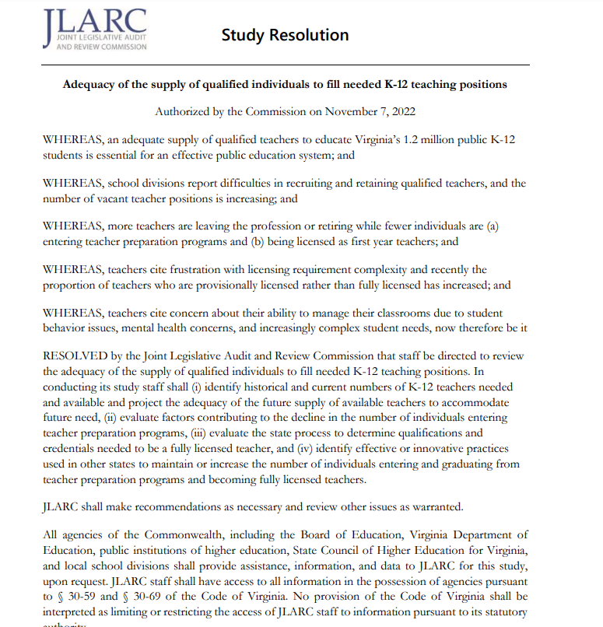

Slide 48
2022 Session Virginia Literacy Act
Effective beginning with the 2024–2025 school year.
§ 22.1-1. Definitions.
"Evidence-based literacy instruction" means structured instructional practices, including sequential, systematic, explicit, and cumulative teaching, that (i) are based on reliable, trustworthy, and valid evidence consistent with science-based reading research; (ii) are used in core or general instruction, supplemental instruction, intervention services, and intensive intervention services; (iii) have a demonstrated record of success in adequately increasing students' reading competency, vocabulary, oral language, and comprehension and in building mastery of the foundational reading skills of phonological and phonemic awareness, alphabetic principle, phonics, spelling, and text reading fluency; and (iv) are able to be differentiated in order to meet the individual needs of students.

Slide 49
§ 22.1-1. Definitions.
"Science-based reading research" means research that (i) applies rigorous, systematic, and objective observational or experimental procedures to obtain valid knowledge relevant to reading development, reading instruction, and reading and writing difficulties, and (ii) explains how proficient reading and writing develop, why some children have difficulties developing key literacy skills, and how schools can best assess and instruct early literacy, including the use of evidence-based literacy instruction practices to promote reading and writing achievement.

Slide 50
Endorsements Impacted
§ 23.1-902.1. Education preparation programs; reading specialists; dyslexia.
12. Every person seeking initial licensure with an endorsement in early/primary education preschool through grade three, elementary education preschool through grade six, special education general curriculum kindergarten through grade 12, special education deaf and hard of hearing preschool through grade 12, or special education blindness/visual impairments preschool through grade 12 or as a reading specialist shall complete study in science-based reading research and evidence-based literacy instruction.
Notes:
Middle school coming

Slide 51
PROFESSIONAL DEVELOPMENT AND TRAINING
VIRGINIA DEPARTMENT OF EDUCATION | VIRGINIA BOARD OF EDUCATION
Provide resources to local school divisions to ensure that each division is able to provide professional development to teachers and reading specialists at no cost to the teachers and reading specialists.
Establish a microcredential program for the reading specialist endorsement area in evidence-based literacy instruction and science-based reading research as well as the identification of and the appropriate interventions, accommodations, and teaching techniques for students with dyslexia or a related disorder. | Issue guidance that determines how the series of microcredentials awarded to teachers would be used to award an add-on endorsement as a reading specialist.

Slide 52
TEACHER EDUCATION AND LICENSURE
VIRGINIA DEPARTMENT OF EDUCATION | VIRGINIA BOARD OF EDUCATION
Provide support to the Board in amending its regulations governing licensure and educator preparation programs. | Amend regulations governing licensure and educator preparation programs to require that: The literacy assessment for certain endorsements include a rigorous test of science-based reading research and evidence-based literacy instruction (already addressed in most recent update to the assessment); Candidates for certain endorsements complete study in science-based reading research and evidence-based literacy instruction; and Enumerated programs provide a program of coursework and require such students to demonstrate mastery in science-based reading research and evidence-based literacy instruction.

Slide 53
HB 418 & 419 (Delaney) Institutions of higher education; education preparation programs; coursework; "audit"
-Establish commission or stakeholder group of independent literacy experts and stakeholders
-The Department of Education shall audit at least once every seven years each education preparation program for compliance with the requirements set forth in subsection A.
Notes:
Hb 418 & 419

Slide 54
VLA Implementation Planning
Literacy Assessments Praxis 2021-2022
K-12 Alignment (Division-wide plans, Advisory, Professional Development, Guidance Core Literacy Curriculum, Strategies)
Establish commission or stakeholder group of independent literacy experts and stakeholders*
Begin development of micro-credential (alternate route provision) & related licensure guidance and regulation creation for Add On Endorsement
Begin regulatory process micro-credentials and endorsement regulations*
EPP Joint Accreditation Visit/State Program Review 7 yrs. cycle (VLA alignment audit) Spring 2024-2025 (1-2 years implementation timeline)
* EPP engagement
Notes:
Incorporate review of specific content or competencies associate with mastery of science of reading in the 7 Year Accreditation/ State Program Review
EPPs can be vendors for offering micro-credentials*

Slide 55
Question and Answers

Slide 56
Contact Information
Joan B. Johnson, Ph.D.
Assistant Superintendent of Teacher Education and Licensure
Email: joan.johnson@doe.virginia.gov
Johnelle M. Torbert , M.E.
Director of Teacher Education
Email: johnelle.torbert@doe.virginia.gov

